Slide 1



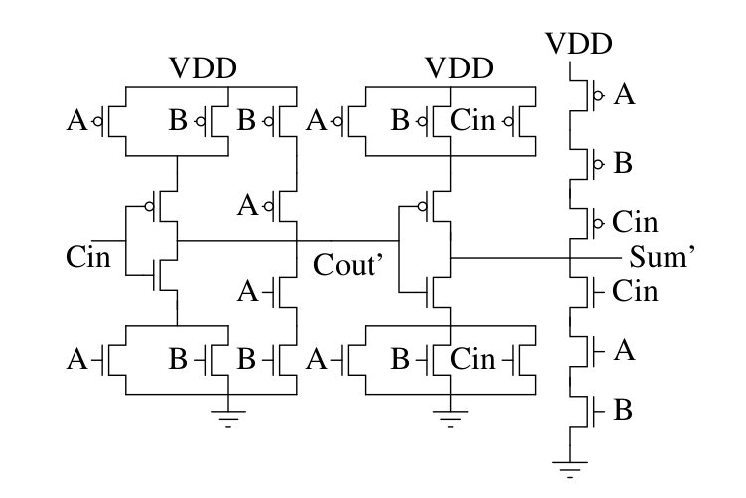
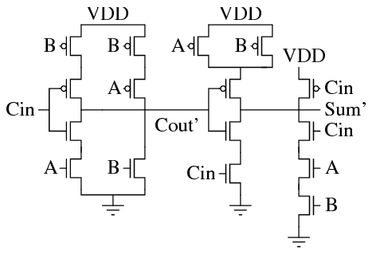
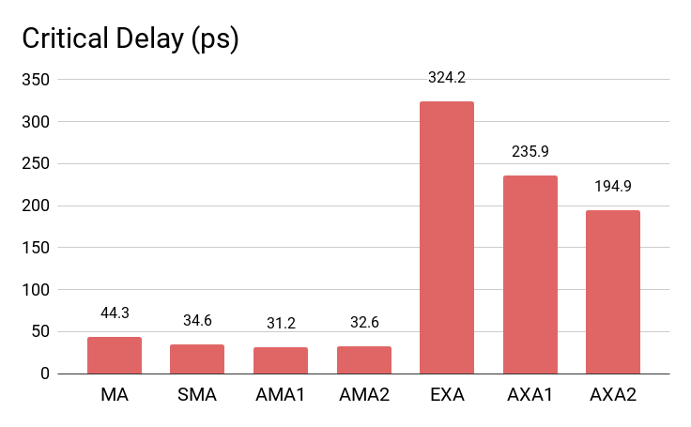
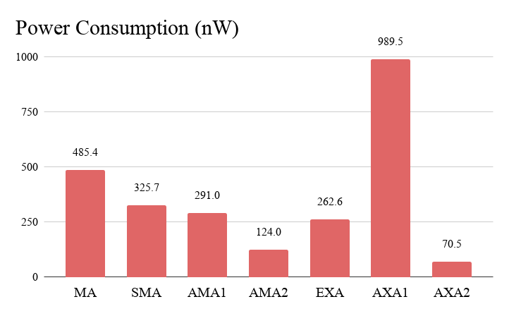
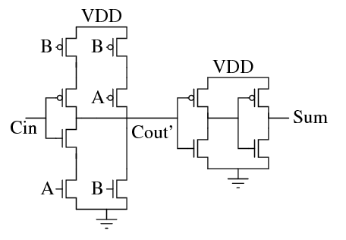
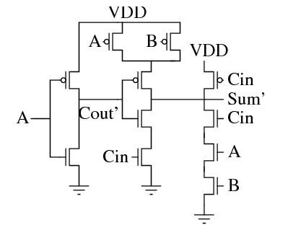
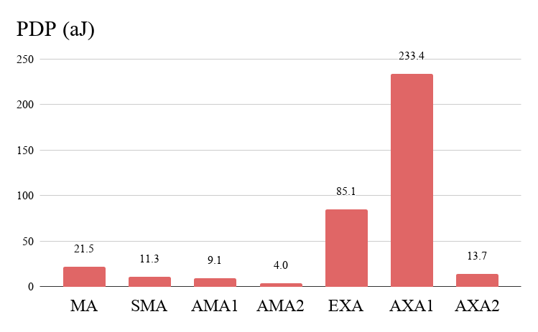
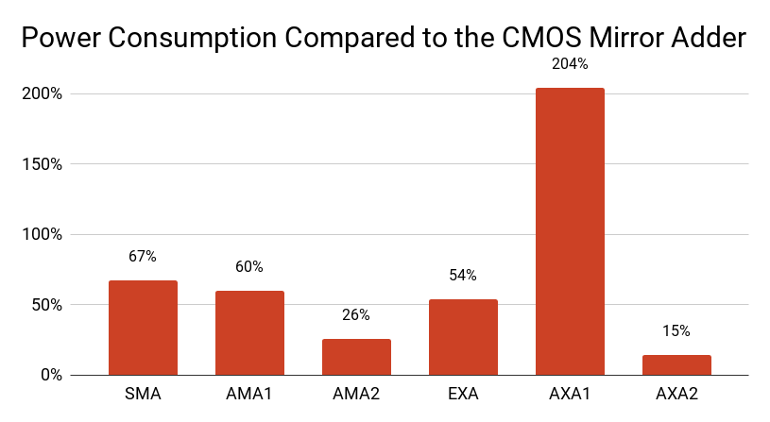
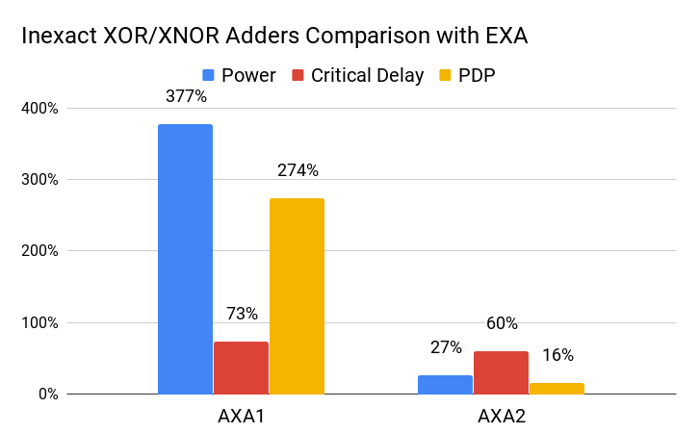
Evaluating Approximate Adders at 16nm
Pedro H. A. Silva and Cristina Meinhardt,
Federal University of Santa Catarina – UFSC
Email: pedro.aquino@grad.ufsc.br, cristina.meinhardt@ufsc.br
This work provides a comparison of a set of approximate full adder circuits in 16nm device technologies, with the goal of identifying how these designs behave in a specific environment compared to conventional exact adders, analyzing performance and power consumption. XNOR-based approximate adders reduce up to 85% the power. The use of logically simplified CMOS adders reduces up to 75% the power and 25% the delay.
Introduction
Methodology
The full adder cell (FA) is one of the critic blocks of an arithmetic unit design
There are a number of error-tolerant applications which would benefit from low-power FA cells
Evaluate Approximate Computing (AC) techniques in FA cells design to power reduction
Electrical level simulations in NGSpice;
16nm High Performance technology (PTM);
5 AC versions of FA;
Comparison:
  Power consumption;
  Critical Delay;
  Power-Delay Product (PDP).
Approximate Adders
Results
1. Mirror Adder-based cells
Overall, there was improvement in both critical delay and power consumption on all analyzed inexact adders.
XOR/XNOR cells have significantly increased critical delay when compared to the Mirror Adder and its approximations.
+ 7.6µW
from boost
+ 3.0µW
from boost
Fig. 1 - Conventional Mirror Adder
Fig. 2 - Simplified Mirror Adder (SMA)
EXA and AXA2 needed boost sources due to low quality of the output signal.
When factoring boost sources needed for the XOR/XNOR designs, AMA2 shows the best result about power consumption.
AMA2 is the best alternative for the FA evaluated.
Compared with Mirror Adder:
This circuit reduces 13 transistors.
26% of delay improvement
74% of power consumption reduction
81% no PDP
Fig. 3 - Approximate Mirror Adder 1 (AMA1)
Fig. 4 - Approximate Mirror Adder 2 (AMA2)
2. XOR/XNOR-based cells
3.8X
The AXA1 presents the worst results to power, delay and PDP.
This shows that applying AC to circuits will not always result in better power performance.
Fig. 5 - Exact XNOR Adder (EXA)
Fig. 6 – Approximate XNOR Adder (AXA2)
Fig. 7 – Approximate XOR Adder (AXA1)
Table 1: Transistor and error count in the FA approximations
Conclusion and Future Work
Topology | Transistor Count | Failing Inputs | Fail Count
SMA | 16 | 010, 100 | 2
AMA1 | 11 | 000, 010, 111 | 3
AMA2 | 11 | 010, 011, 100 | 3
AXA1 | 8 | 010, 011, 100, 101 | 4
AXA2 | 6 | 000, 001, 100, 110 | 4
Approximate Computing is a technique for power reduction in error-tolerant applications.
The best power, delay and PDP improvement was observed in the AMA2.
Future work will investigate the impact of adopting the approximated full adders on:
  hardware designs to process noisy real-world data;
  video applications.
São Paulo, August 2019

